Slide 1

Final Engagement
Attack, Defence & Analysis of a Vulnerable Network

Slide 2



Summary
It was discovered that two VMs on the network were vulnerable to attack:
Target 1 - 192.168.1.110
Target 2 - 192.168.1.115
Each VM functions as an Apache web server and has SSH enabled, so ports 80 and 22 are possible ports of entry for attackers. A number of vulnerabilities were found.
Critical
High
Medium

Slide 3
Table of Contents
Network topology
Reconnaissance
Access, Exploration and Exploitation
Vulnerabilities, Mitigation and Hardening
Wireshark Network Analysis

Slide 4
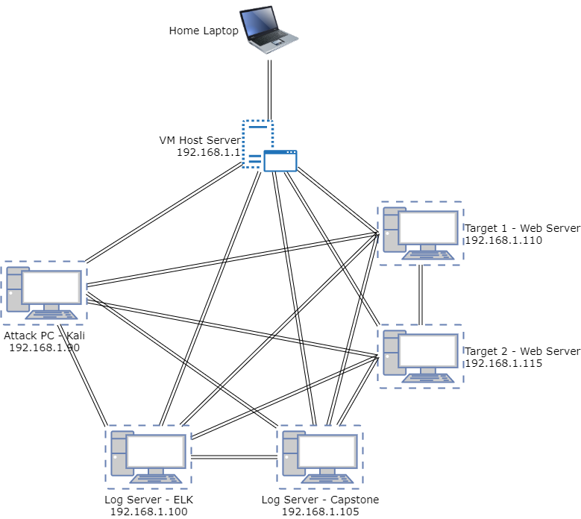
Network Topology
Network Address range: 192.168.1.0/24
Machines
VM Host Server (Windows 10) 192.168.1.1
Attack PC – Kali (Linux) 192.168.1.90
ELK Server(Linux) 192.168.1.100
Capstone Server (Linux) 192.168.1.105
Target 1 (Linux) 192.168.1.110
Target 2 (Linux) 192.168.1.115

Slide 5

Reconnaissance

Slide 6
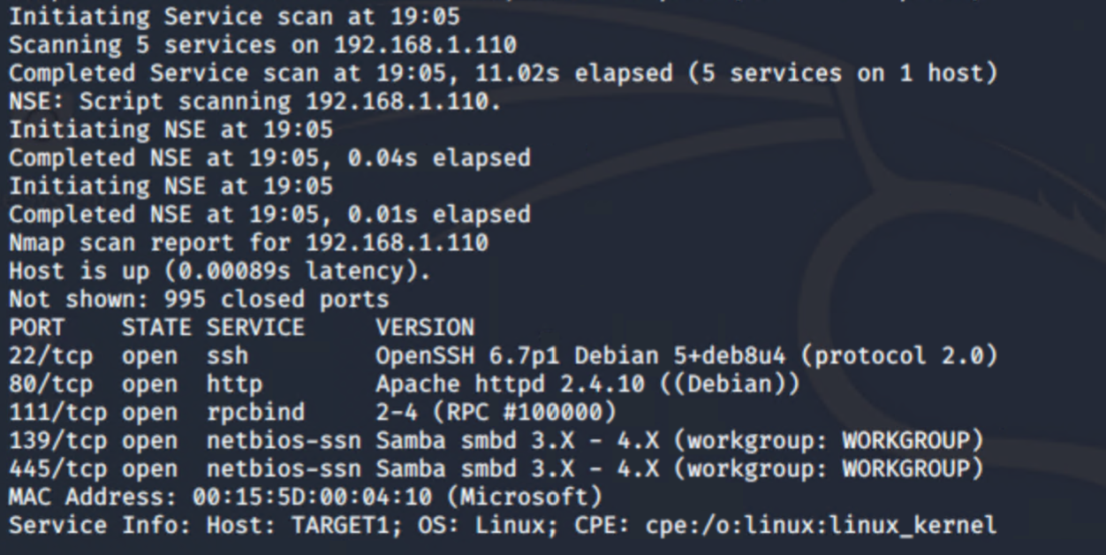
Nmap Target 1
Target 2

Slide 7
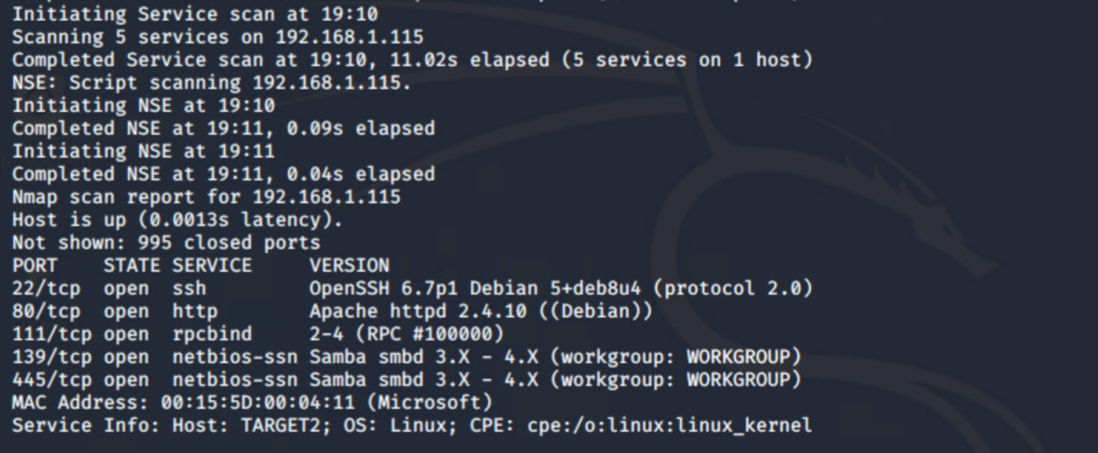
Nmap Target 2
Target 2

Slide 8
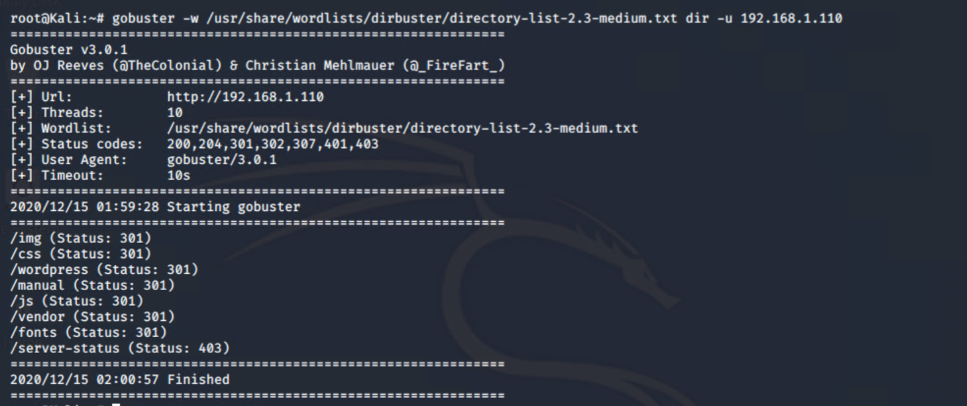
Gobuster Target 1

Slide 9
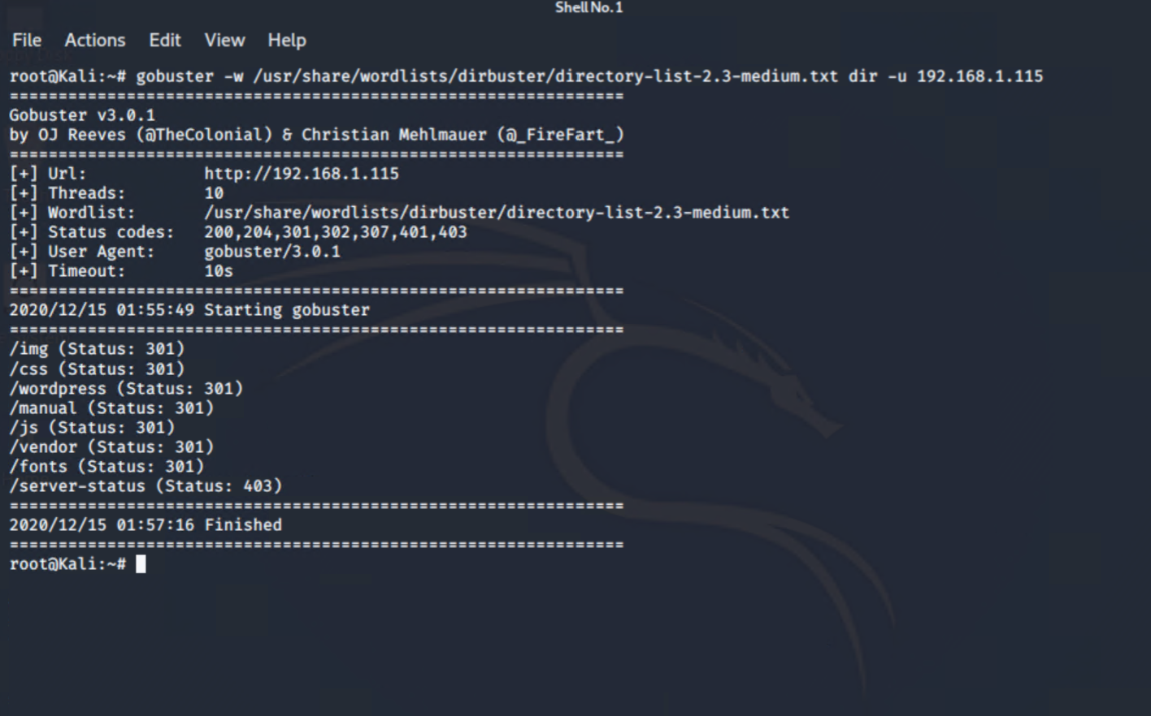
Gobuster Target 2

Slide 10
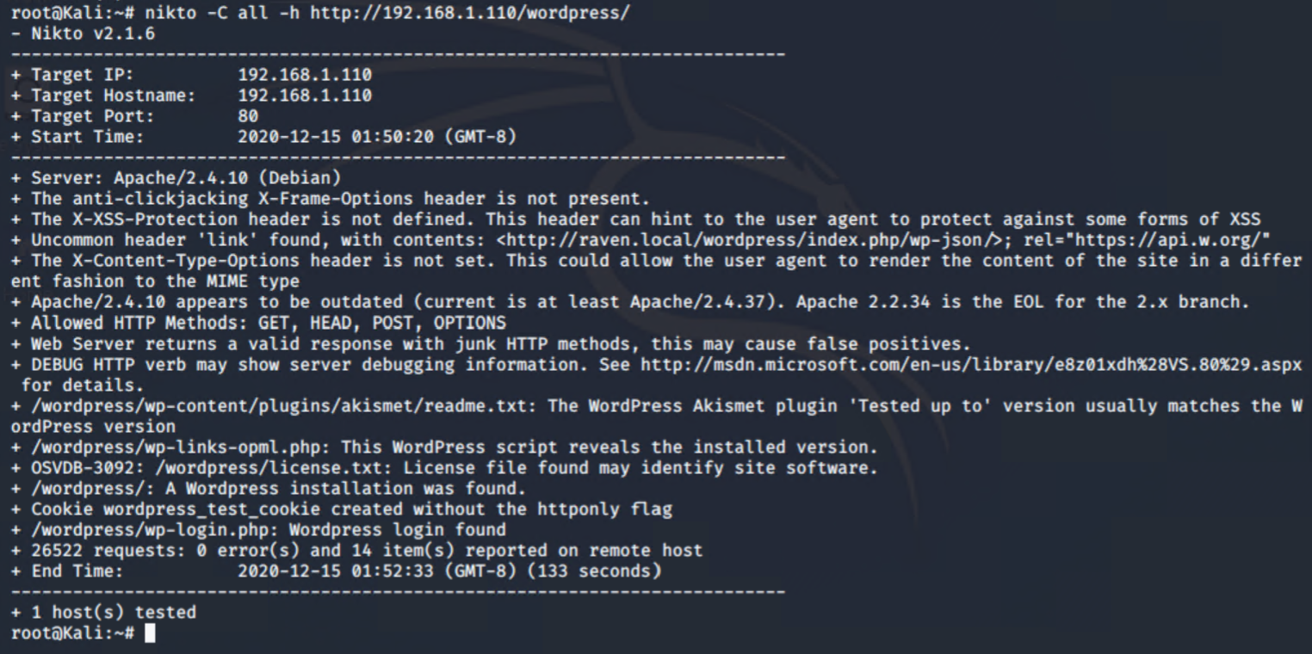
Nikto Target 1

Slide 11
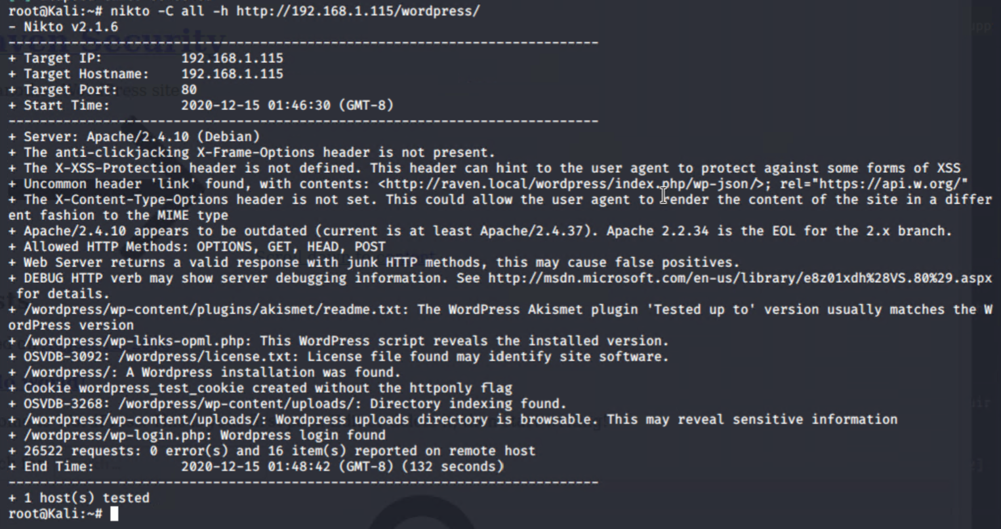
Nikto Taget 2

Slide 12
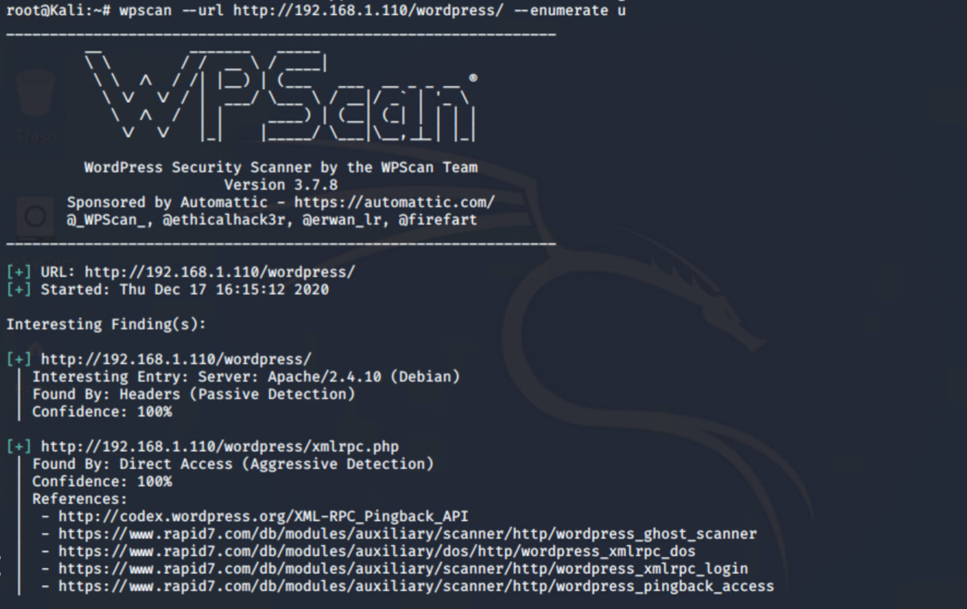
WPScan Target 1a

Slide 13
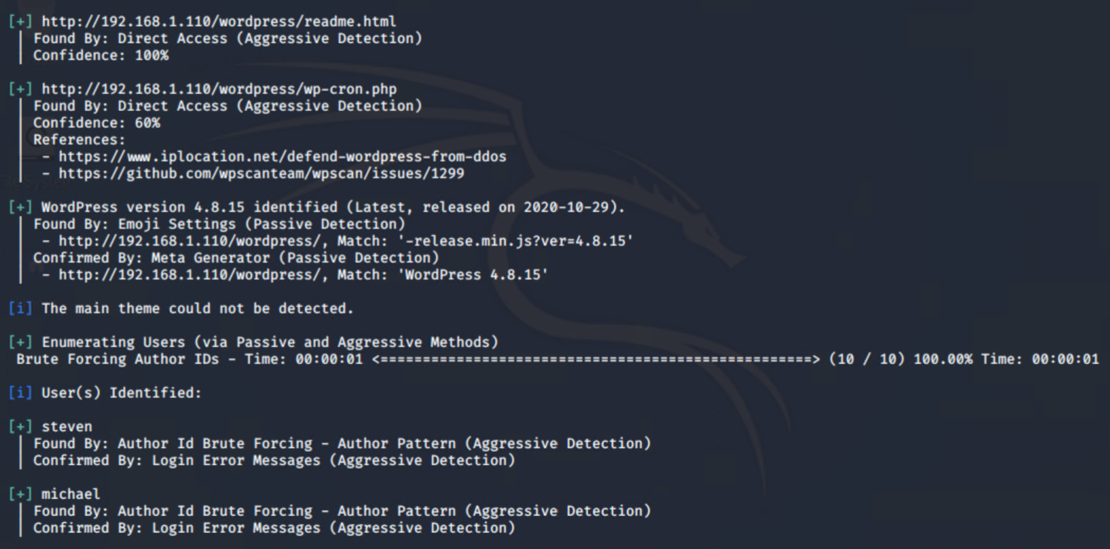
WPScan Target 1b

Slide 14
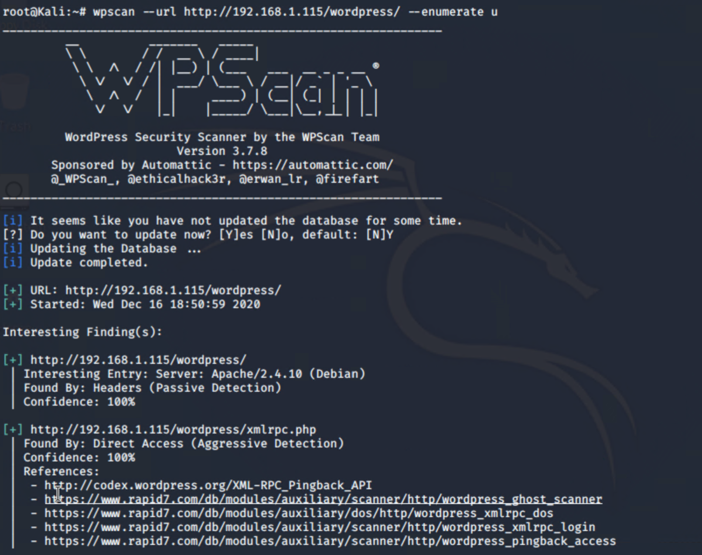
WPScan Target 2a

Slide 15
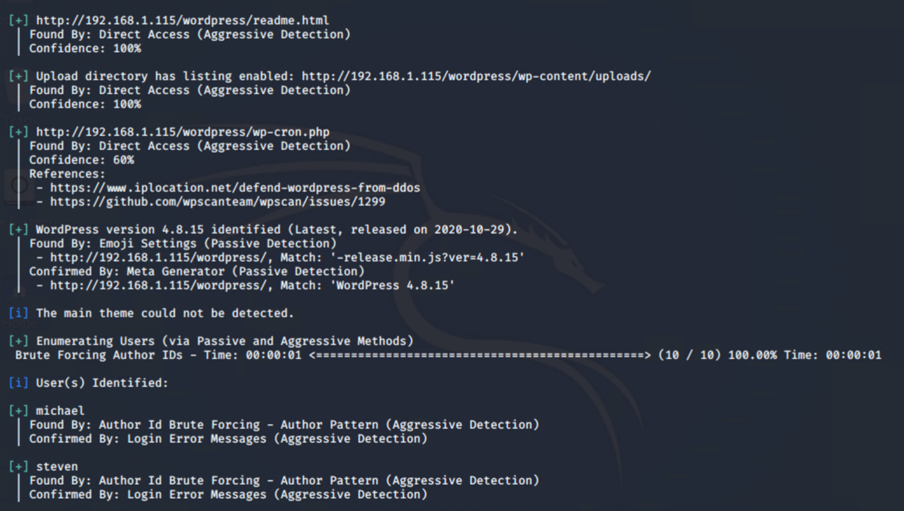
Wpscan Target 2b

Slide 16

Access, Exploration and Exploitation

Slide 17
Access
The previous scans showed a number of initial attack vectors to gain access to the web servers:
Open SSH version 6.7p1
Multiple vulnerabilities CVE-2016-6210, CVE-2016-6515, CVE-2015-8325
Permissions, Privileges and Access control CVE-2015-5600
HTTP port 80 open
OPTIONS, GET, HEAD and POST allowed
Apache version 2.4.10
Multiple vulnerabilities CVE-2017-7679, CVE-2017-7668, CVE-2017-3169, CVE-2017-3167
Wordpress version 4.8.15
Logins found, michael and steven
Upload directory is browsable
Version vulnerable to CVE-2020-4049
Rpcbind port 111 open version 2-4
Potential DoS attack CVE-2017-8779

Slide 18
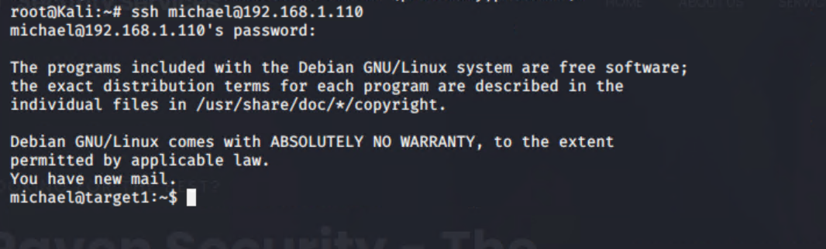
Target 1 Attack
The earlier wpscan with enumeration shows two users that we can use for an initial attack, micheal and steven. When attempting to connect with Micheal’s account it was easy to simply guess his password was michael.

Slide 19
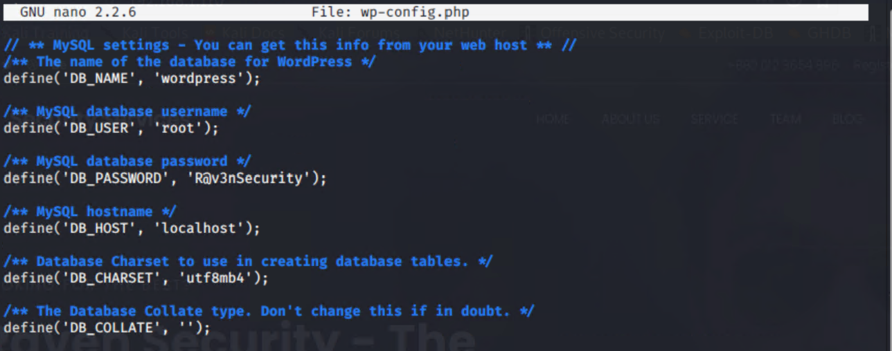
Target 1 Attack (cont.)
Using micheals account it was possible to navigate to /var/www/html and view the wp-config.php file

Slide 20
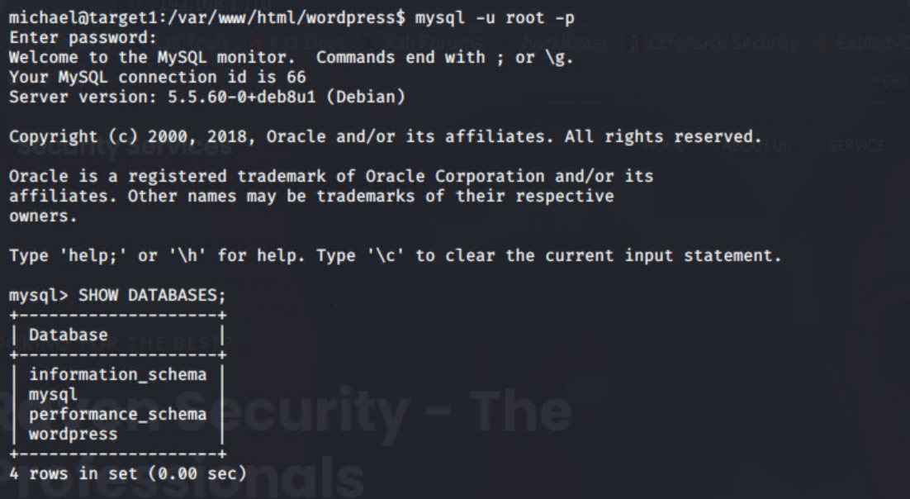
Target 1 Attack (cont.)
With the revealed root password a MYSQL connection could be made

Slide 21
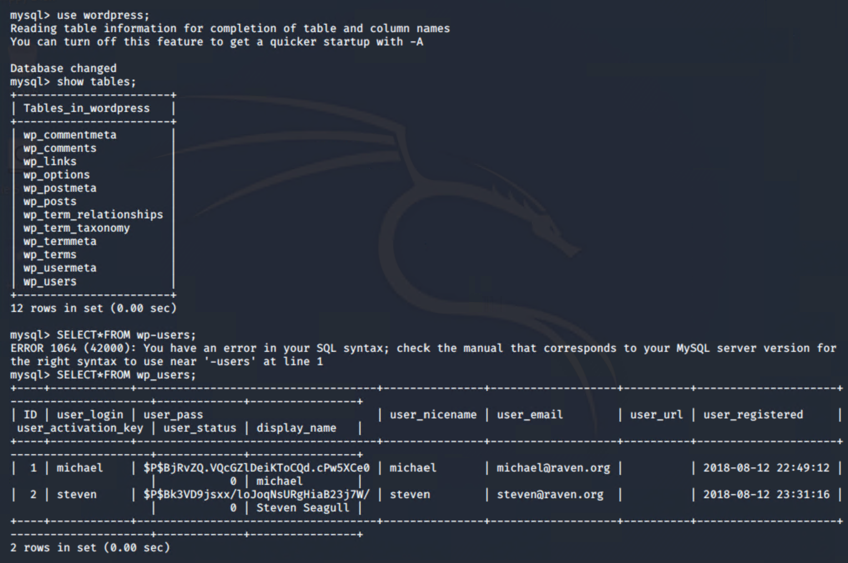
Target 1 Attack (cont.)
The user account password hashes could then be exposed

Slide 22
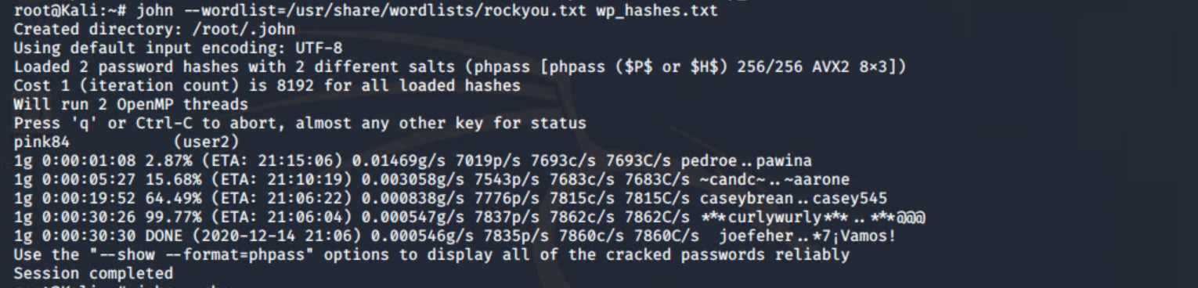
Target 1 Attack (cont.)
Using john the ripper it was possible to crack Steven’s password – pink84

Slide 23
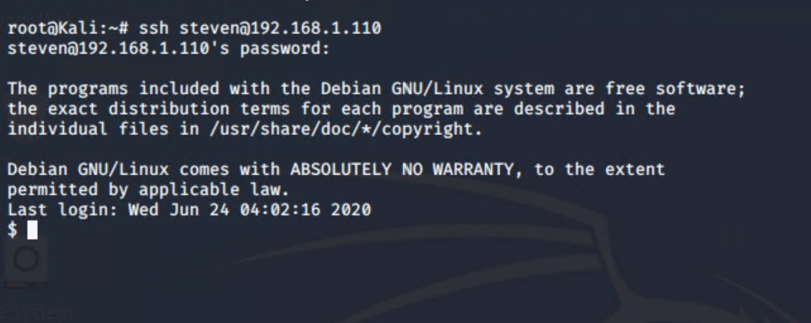
Target 1 Attack (cont.)
An ssh connection using stevens credentials was then completed

Slide 24
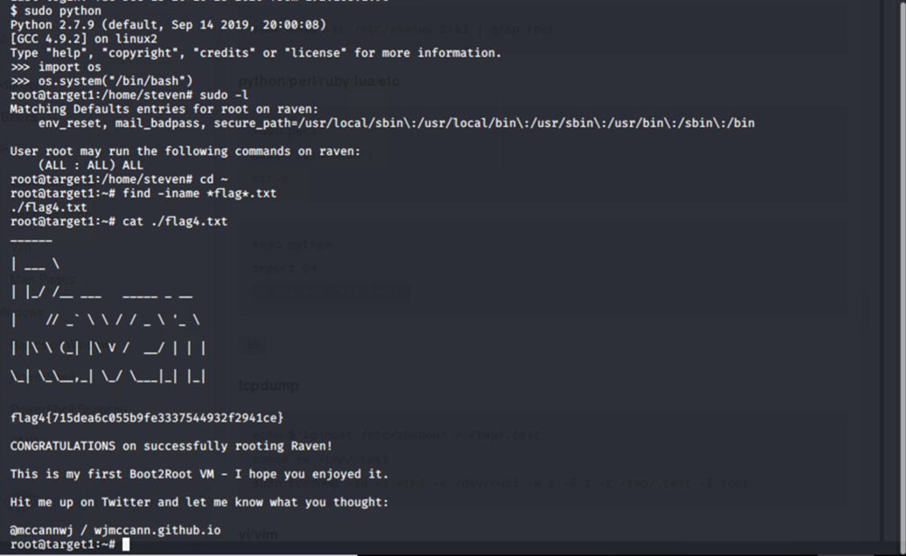
Target 1 Attack (cont.)
Escalation to root account was completed using a sudo python hack.

Slide 25
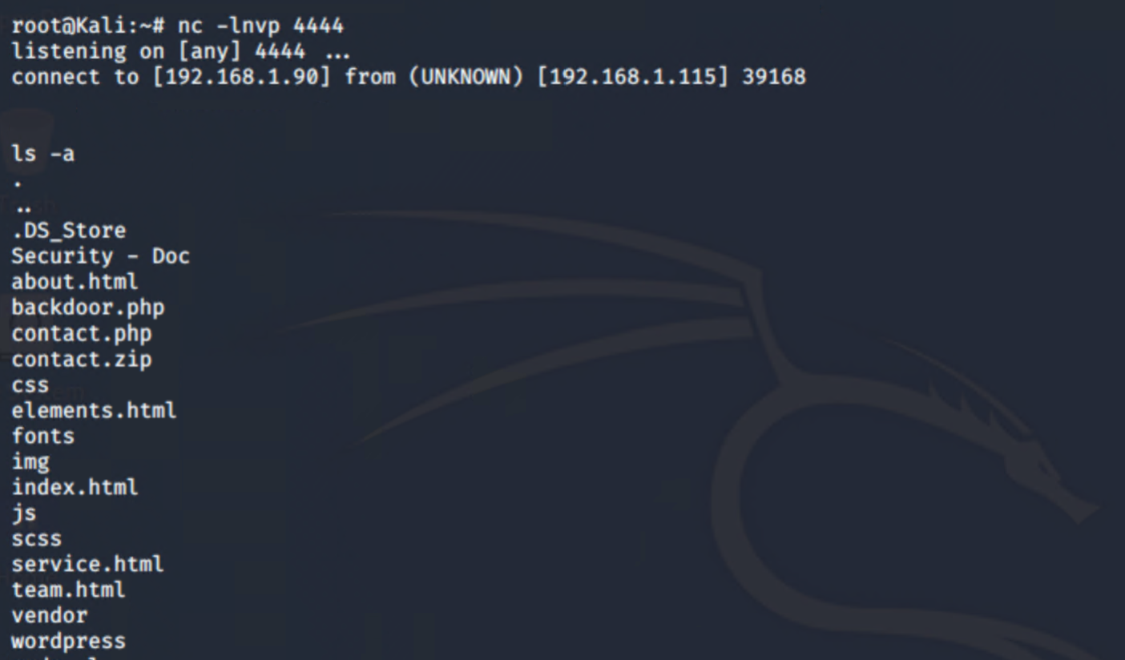
Target 2 Attack
Target 2 was compromised by using a vulnerability to command injection attacks to open a reverse shell

Slide 26
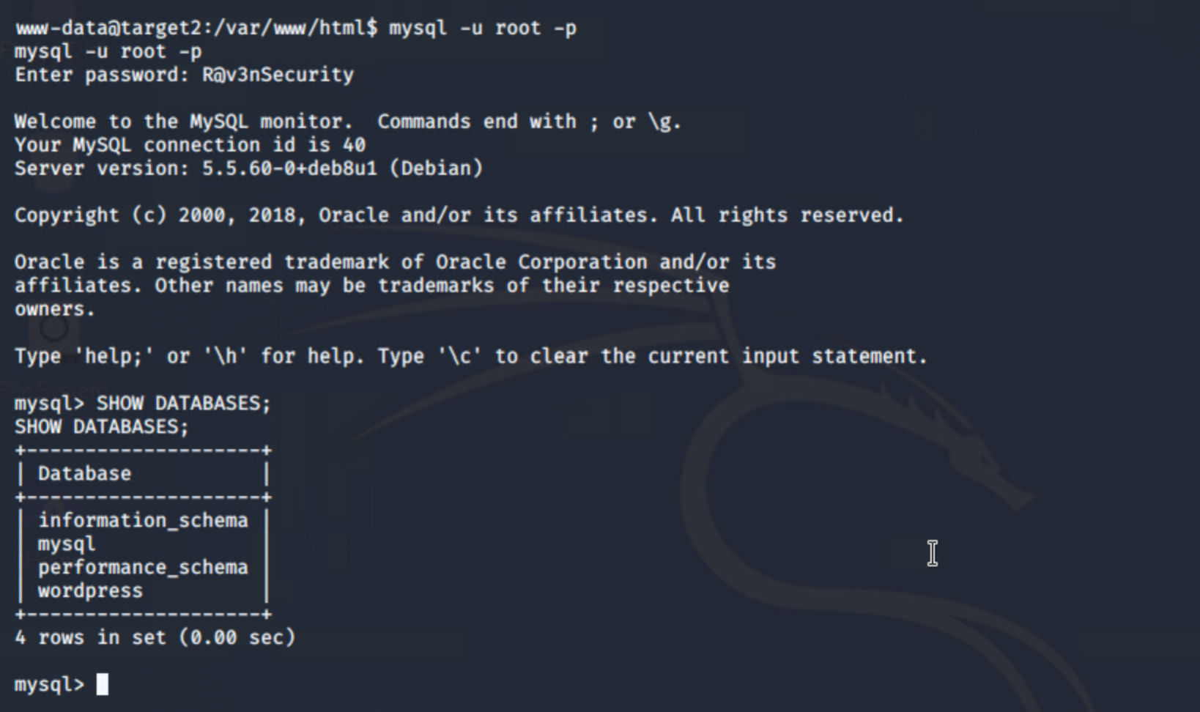
Target 2 Attack (cont.)
As with Target 1 MYSQL credentials were available and a connection could be made

Slide 27
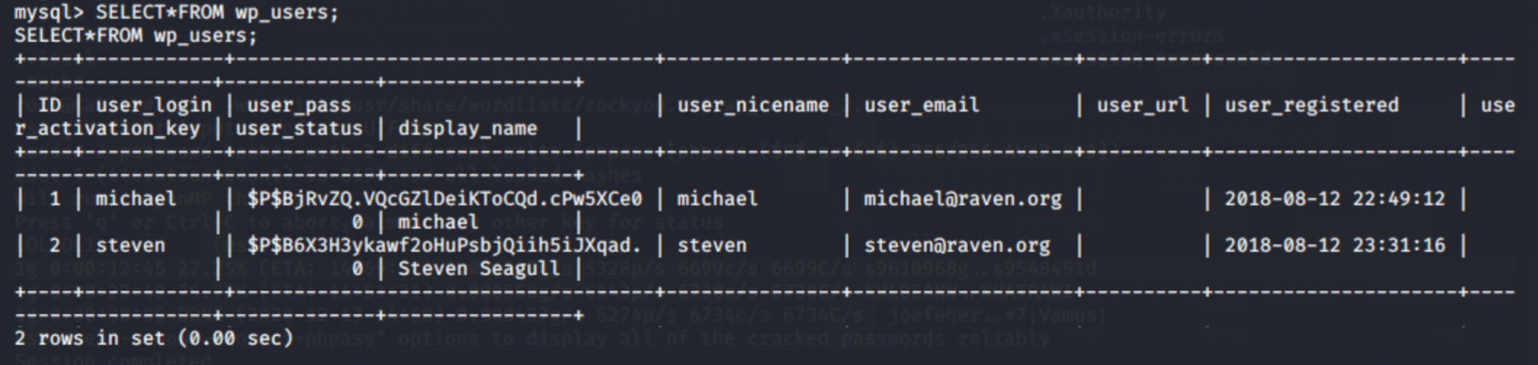
Target 2 Attack (cont.)
Password hashes were visible

Slide 28
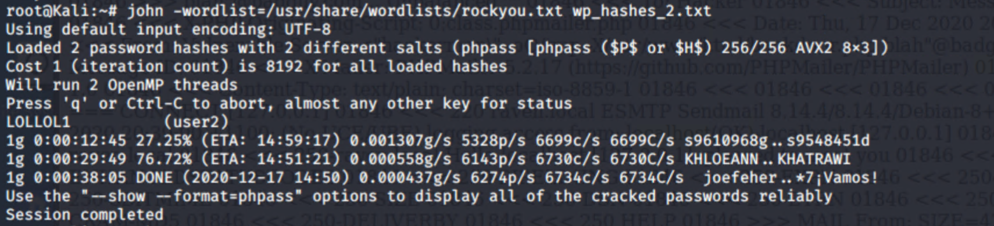
Target 2 Attack (cont.)
John the ripper was able to crack user 2 steven

Slide 29
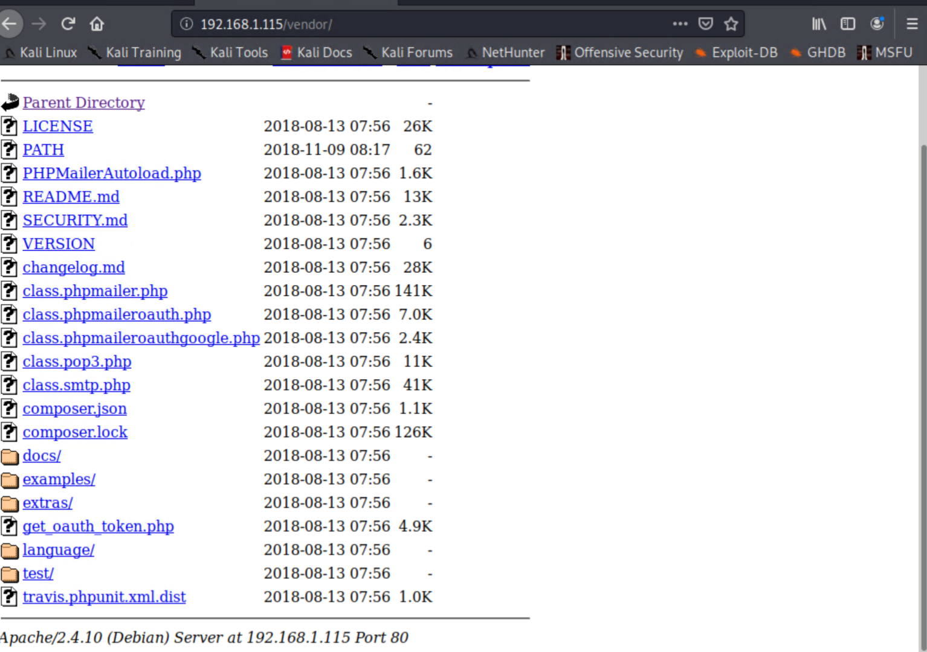
Target 2 Attack (cont.)
Navigating to the /vendor folder showed phpmailer. The /VERSION folder shows version 5.2.16

Slide 30
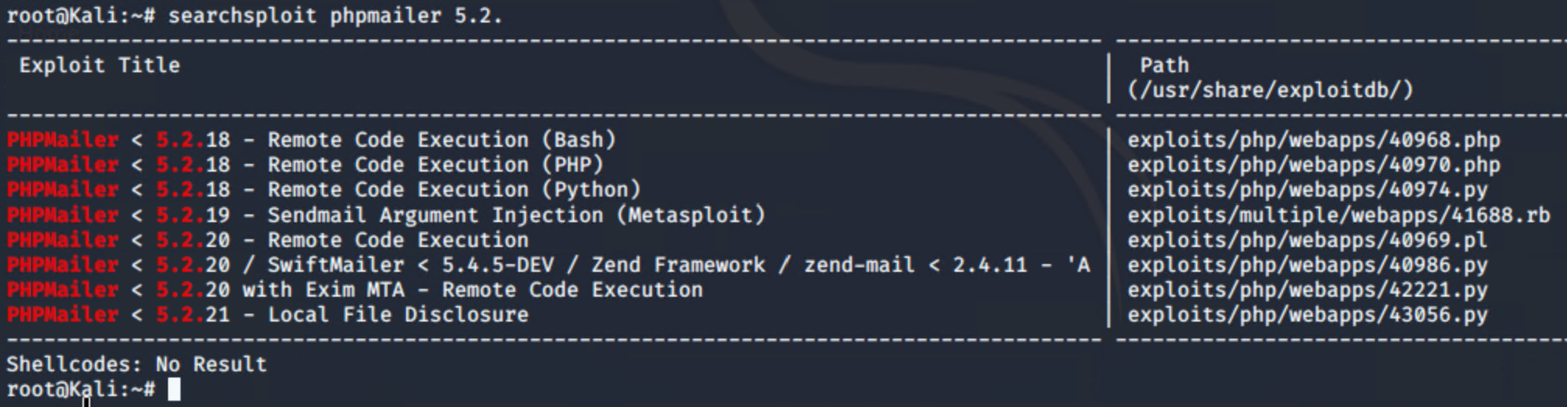
Target 2 Attack (cont.)
Searchsploit exposed a number of vulnerabilities

Slide 31

Vulnerabilities, Mitigation and Hardening

Slide 32
Open SSH version 6.7p1
CVE-2016-6210: sshd in OpenSSH before 7.3, when SHA256 or SHA512 are used for user password hashing, uses BLOWFISH hashing on a static password when the username does not exist, which allows remote attackers to enumerate users by leveraging the timing difference between responses when a large password is provided.
CVSS Rating: 5.9 Medium
Mitigation: Upgrade OpenSSH to version 7.3 or later
CVE-2016-6515: The auth_password function in auth-passwd.c in sshd in OpenSSH before 7.3 does not limit password lengths for password authentication, which allows remote attackers to cause a denial of service (crypt CPU consumption) via a long string.
CVSS Rating: 7.5 High
Mitigation: Upgrade OpenSSH to version 7.3 or later
CVE-2015-8325: The do_setup_env function in session.c in sshd in OpenSSH through 7.2p2, when the UseLogin feature is enabled and PAM is configured to read .pam_environment files in user home directories, allows local users to gain privileges by triggering a crafted environment for the /bin/login program, as demonstrated by an LD_PRELOAD environment variable.
CVSS Rating: 7.8 High
Mitigation: Upgrade OpenSSH to version 7.3 or later
CVE-2015-5600: The kbdint_next_device function in auth2-chall.c in sshd in OpenSSH through 6.9 does not properly restrict the processing of keyboard-interactive devices within a single connection, which makes it easier for remote attackers to conduct brute-force attacks or cause a denial of service (CPU consumption) via a long and duplicative list in the ssh -oKbdInteractiveDevices option, as demonstrated by a modified client that provides a different password for each pam element on this list.
CVSS Rating: N/A
Mitigation: Upgrade OpenSSH to version 7.3 or later

Slide 33
SSH General Hardening
Set Idle timeout interval
Disable empty passwords
Disable X11 forwarding
Limit max authentication attempts
Disable Root Login
Strong passwords/passphrase for ssh users and keys
Keep SSH updated

Slide 34
Apache version 2.4.10
CVE-2017-7679: In Apache httpd 2.2.x before 2.2.33 and 2.4.x before 2.4.26, mod_mime can read one byte past the end of a buffer when sending a malicious Content-Type response header.
Rating: 9.8 CRITICAL
Mitigation: Upgrade Apache to version 2.4.26 or later
CVE-2017-7668: The HTTP strict parsing changes added in Apache httpd 2.2.32 and 2.4.24 introduced a bug in token list parsing, which allows ap_find_token() to search past the end of its input string. By maliciously crafting a sequence of request headers, an attacker may be able to cause a segmentation fault, or to force ap_find_token() to return an incorrect value.
Rating: 9.8 CRITICAL
Mitigation: Upgrade Apache to version 2.4.26 or later
CVE-2017-3169: In Apache httpd 2.2.x before 2.2.33 and 2.4.x before 2.4.26, mod_ssl may dereference a NULL pointer when third-party modules call ap_hook_process_connection() during an HTTP request to an HTTPS port.
Rating: 9.8 CRITICAL
Mitigation: Upgrade Apache to version 2.4.26 or later
CVE-2017-3167: In Apache httpd 2.2.x before 2.2.33 and 2.4.x before 2.4.26, use of the ap_get_basic_auth_pw() by third-party modules outside of the authentication phase may lead to authentication requirements being bypassed.
Rating: 9.8 CRITICAL
Mitigation: Upgrade Apache to version 2.4.26 or later

Slide 35
Apache General Hardening
Disable the server-info Directive
Disable Directory Listing
Use An Appropriate User and Group
Change default passwords/use strong complex passwords
Enable Only the Required Modules
Restrict Unwanted Services
Use a Web Application Firewall
Enable Logging

Slide 36
Wordpress version 4.8.15
CVE-2020-4049: In affected versions of WordPress, when uploading themes, the name of the theme folder can be crafted in a way that could lead to JavaScript execution in /wp-admin on the themes page. This does require an admin to upload the theme, and is low severity self-XSS. This has been patched in version 5.4.2, along with all the previously affected versions via a minor release (5.3.4, 5.2.7, 5.1.6, 5.0.10, 4.9.15, 4.8.14, 4.7.18, 4.6.19, 4.5.22, 4.4.23, 4.3.24, 4.2.28, 4.1.31, 4.0.31, 3.9.32, 3.8.34, 3.7.34).
Rating: 2.4 Low
Mitigation: Upgrade Wordpress to version 5.4.2
General security mitigation for wordpress:
Disable File Editing
Rename the administrative account
Change the table_prefix
Enforce strong passwords and 2 Factor authentication
Use SFTP encryption
Limit file permissions
Require an HTTPS SSL encrypted connection for administration

Slide 37
rpcbind Version 2-4
CVE-2017-8779: rpcbind through 0.2.4, LIBTIRPC through 1.0.1 and 1.0.2-rc through 1.0.2-rc3, and NTIRPC through 1.4.3 do not consider the maximum RPC data size during memory allocation for XDR strings, which allows remote attackers to cause a denial of service (memory consumption with no subsequent free) via a crafted UDP packet to port 111, aka rpcbomb.
Rating: 7.5 High
Mitigation: upgrade rpcbind version to 2-5 or later
General security mitigation for rpcbind
Create a whitelist of hosts that are allowed access

Slide 38
PHPMailer Version 5.2.16
CVE-2018-19296: PHPMailer before 5.2.27 and 6.x beforee 6.0.6 is vulnerable to an object injection attack.
Rating: 8.8 High
Mitigation: Upgrade to PHPMailer 6.2.0 or later
CVE-2017-5223: An issue was discovered in PHPMailer before 5.2.22. PHPMailer's msgHTML method applies transformations to an HTML document to make it usable as an email message body. One of the transformations is to convert relative image URLs into attachments using a script-provided base directory. If no base directory is provided, it resolves to /, meaning that relative image URLs get treated as absolute local file paths and added as attachments. To form a remote vulnerability, the msgHTML method must be called, passed an unfiltered, user-supplied HTML document, and must not set a base directory.
Rating: 5.5 Medium
Mitigation: Upgrade to PHPMailer 6.2.0 or later
CVE-2016-10033: The mailSend function in the isMail transport in PHPMailer before 5.2.18 might allow remote attackers to pass extra parameters to the mail command and consequently execute arbitrary code via a \" (backslash double quote) in a crafted Sender property.
Rating: 9.8 Critical
Mitigation: Upgrade to PHPMailer 6.2.0 or later
CVE-2016-10045: The isMail transport in PHPMailer before 5.2.20 might allow remote attackers to pass extra parameters to the mail command and consequently execute arbitrary code by leveraging improper interaction between the escapeshellarg function and internal escaping performed in the mail function in PHP. NOTE: this vulnerability exists because of an incorrect fix for CVE-2016-10033.
Rating: 9.8 Critical
Mitigation: Upgrade to PHPMailer 6.2.0 or later

Slide 39
HTTP and General System Hardening
Hide PHP information and the web server version
Enable CSP and HSTS
Use the X-Frame-Options header to deny iframes.
Apply the ‘nosniff’ variable to the X-Content-Type-Options header
Disable HTTP enforce HTTPS and use only TLS 1.2
Automatically apply OS updates, service packs, and patches
Restricting unauthorized access and implementing privileged user controls
Require all users to implement strong passwords and change them on a regular basis
Multi-Factor Authentication
Logging all activity, errors, and warnings

Slide 40
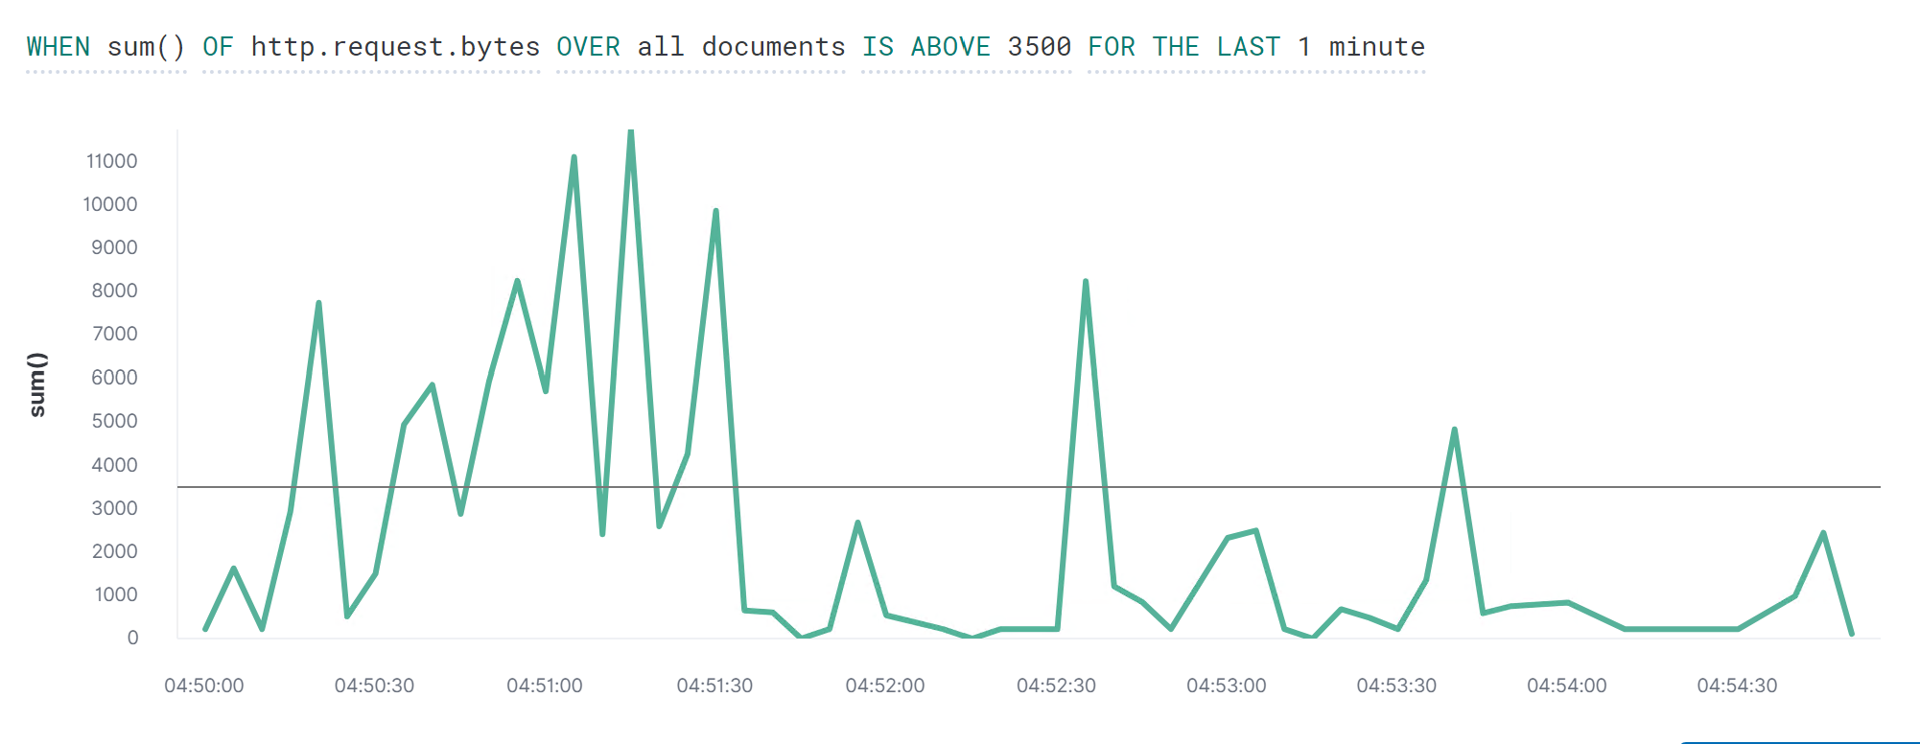
Alert 1 Sum of HTTP Requests in Bytes Packetbeat Detect Brute force attacks

Slide 41
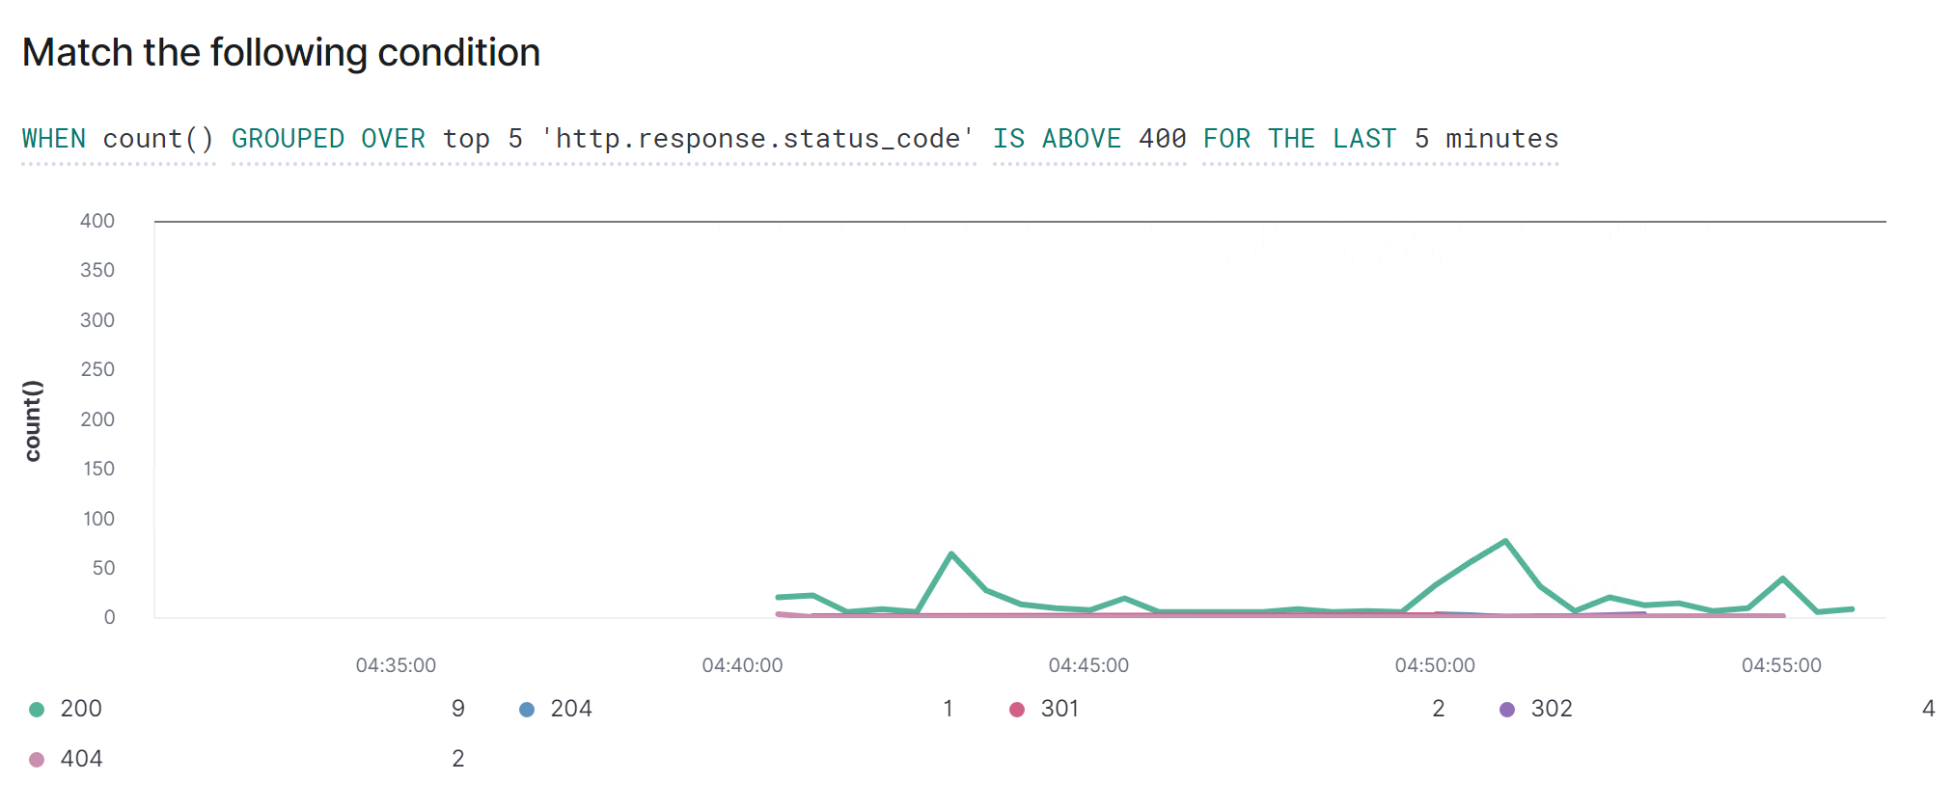
Alert 2 Count of HTTP response codes Packetbeat Detect reconnaissance attempts

Slide 42
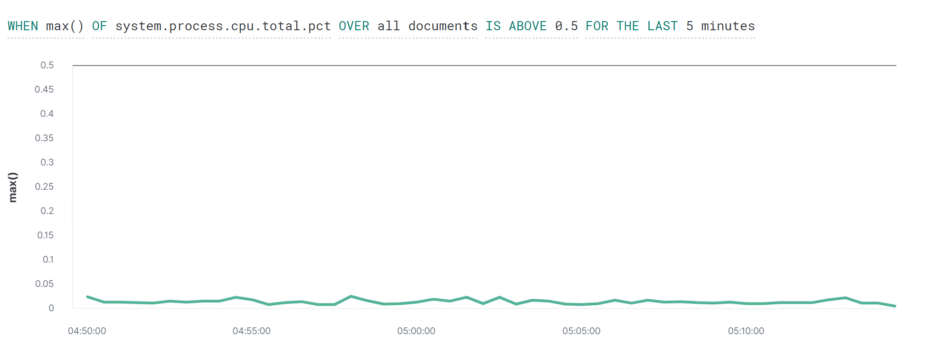
Alert 3 CPU system process use Metricbeat Detect attacks in progress

Slide 43

Wireshark Network Analysis

Slide 44
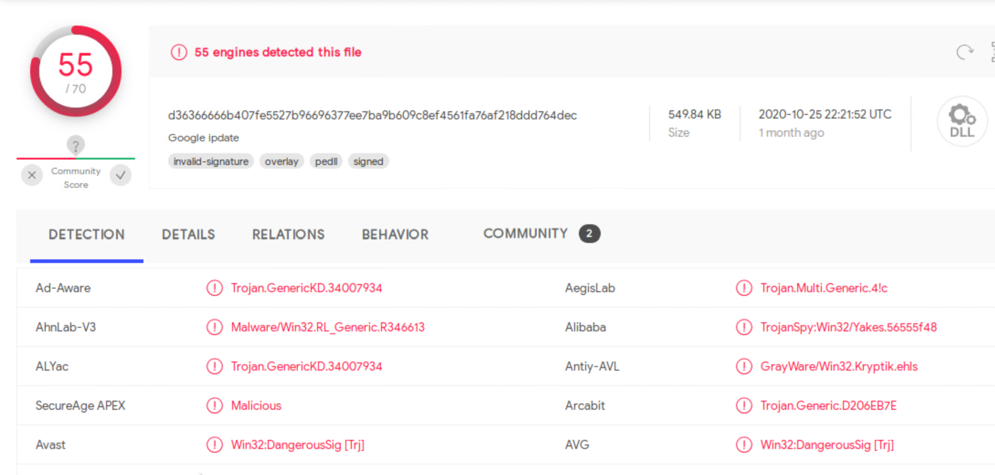
Time Thieves
Two users have set up a private domain called frank-n-ted.com.
The IP address of the Domain controller is 10.6.12.12.
The user with IP address 10.16.12.203 downloaded a file called June11.dll that contained a trojan.

Slide 45
Vulnerable Windows Machines
The following infected machine was discovered in the 172.16.4.0/24 range.
Host name: Rotterdam-PC
IP address: 172.16.4.205
MAC address: 00:59:07:b0:63:a4
Username: Matthijs Devries

Slide 46
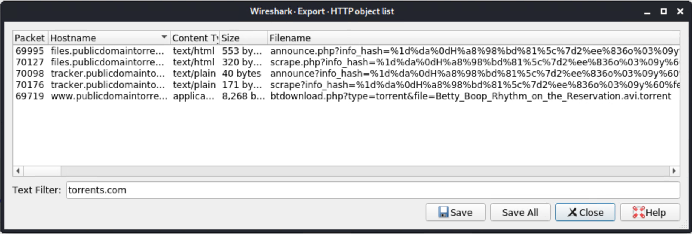
Illegal Downloads
A torrent file, Betty_Boop_rhythm_on_the_reservation.avi, was downloaded by a machine with the following details:
IP address: 10.0.0.201
MAC address: 00:16:17:18:66:c8
Windows username: Elmer Blanco
OS version: Windows 10

Slide 47
General Network Hardening & Best Practise
Educate employees on appropriate and safe behaviour
Blacklist sites such as torrent sites, YouTube and streaming sites
Privileged access control measures
Strong passwords and Multi-factor authentication
Implement network segmentation and segregation
Monitor systems continually and regularly check logs
Keep all security patches and software versions up to date
Use Antivirus software and Firewalls
Perform Disaster Recovery Planning

